Slide 1
Java Concurrency and Multithreading
Presented by:
DEBENDU KUMAR

Slide 2
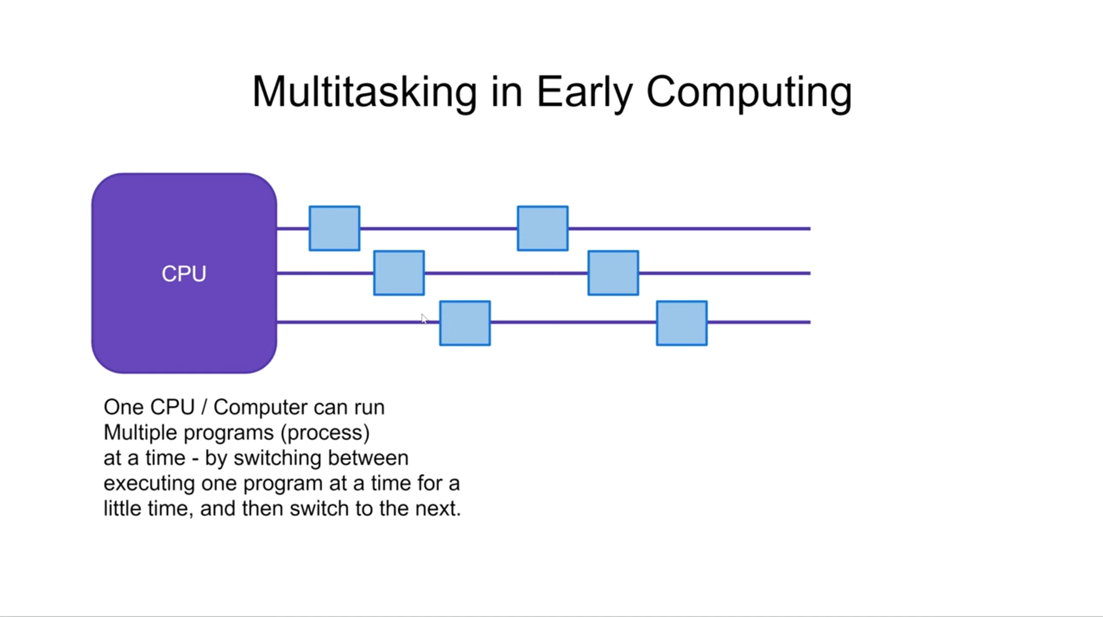
Notes:
Democratisation (means making something accessible and available to a wider range of people) and decentralisation (refers to distribution of power to authority away from a central authority or governing body to a local or regional authorities or communities)
Inclusivity and access for sellers especially small and medium enterprise as well as local businesses

Slide 3
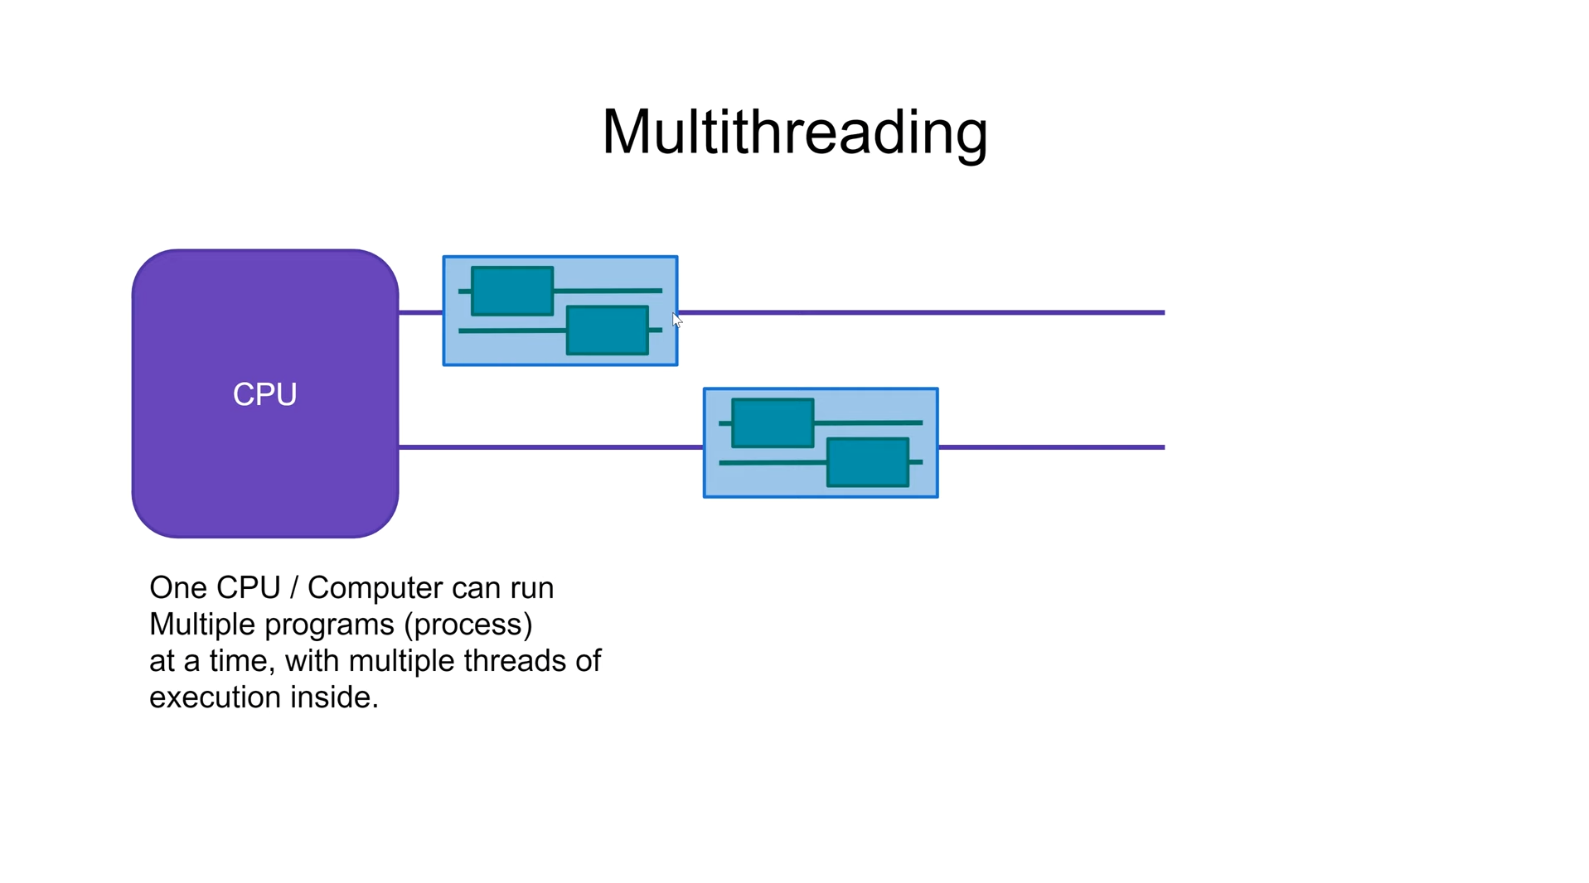
Notes:
Democratisation (means making something accessible and available to a wider range of people) and decentralisation (refers to distribution of power to authority away from a central authority or governing body to a local or regional authorities or communities)
Inclusivity and access for sellers especially small and medium enterprise as well as local businesses

Slide 4
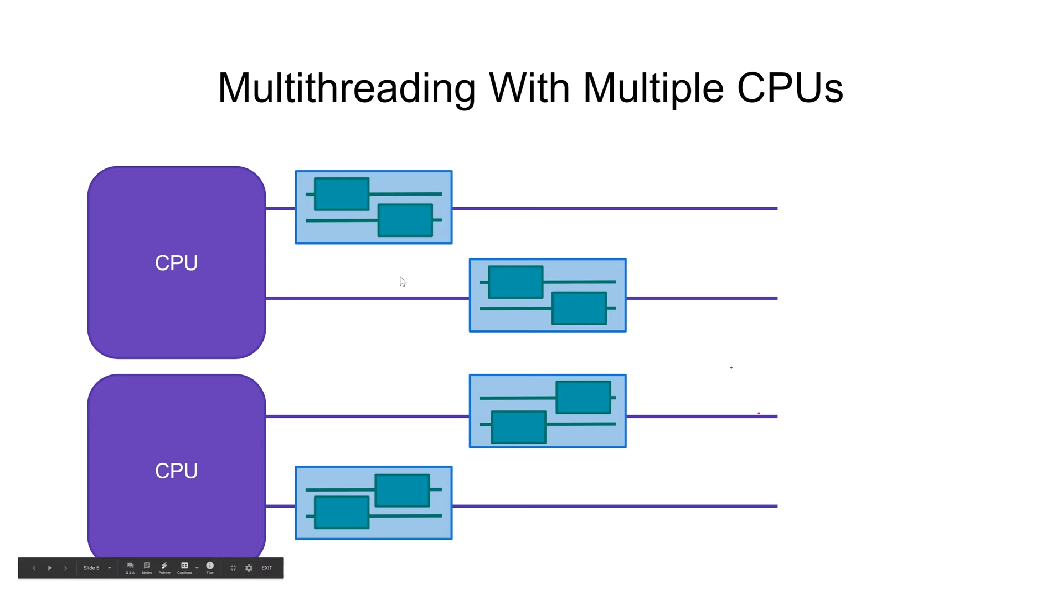
Notes:
Democratisation (means making something accessible and available to a wider range of people) and decentralisation (refers to distribution of power to authority away from a central authority or governing body to a local or regional authorities or communities)
Inclusivity and access for sellers especially small and medium enterprise as well as local businesses

Slide 5
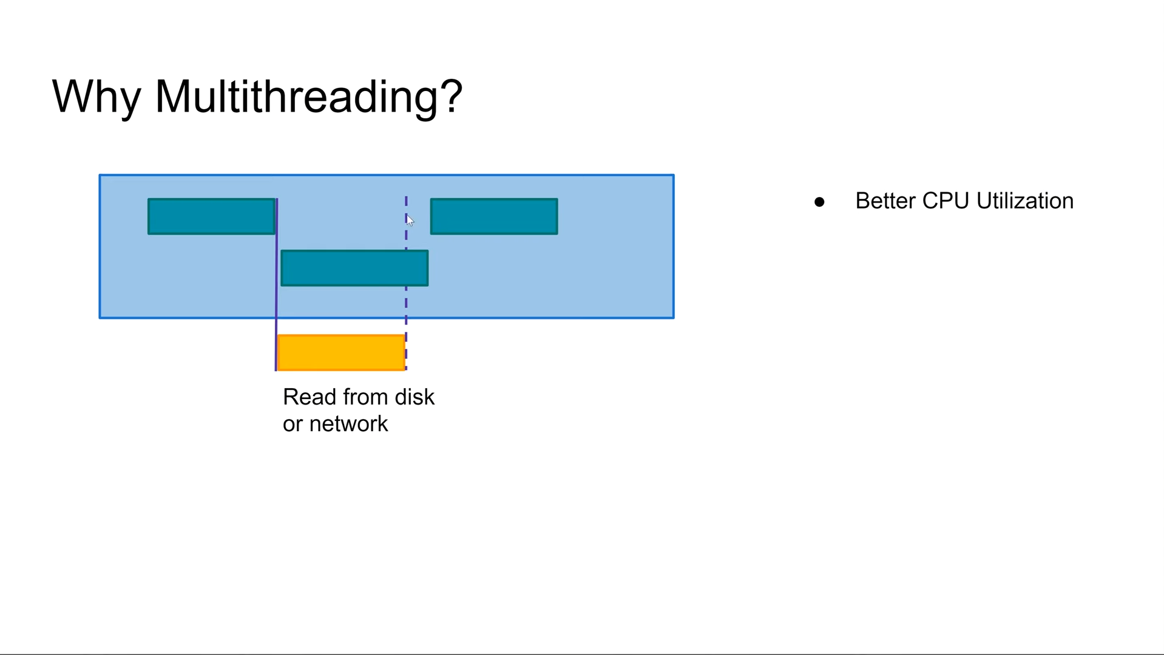
Notes:
Democratisation (means making something accessible and available to a wider range of people) and decentralisation (refers to distribution of power to authority away from a central authority or governing body to a local or regional authorities or communities)
Inclusivity and access for sellers especially small and medium enterprise as well as local businesses

Slide 6
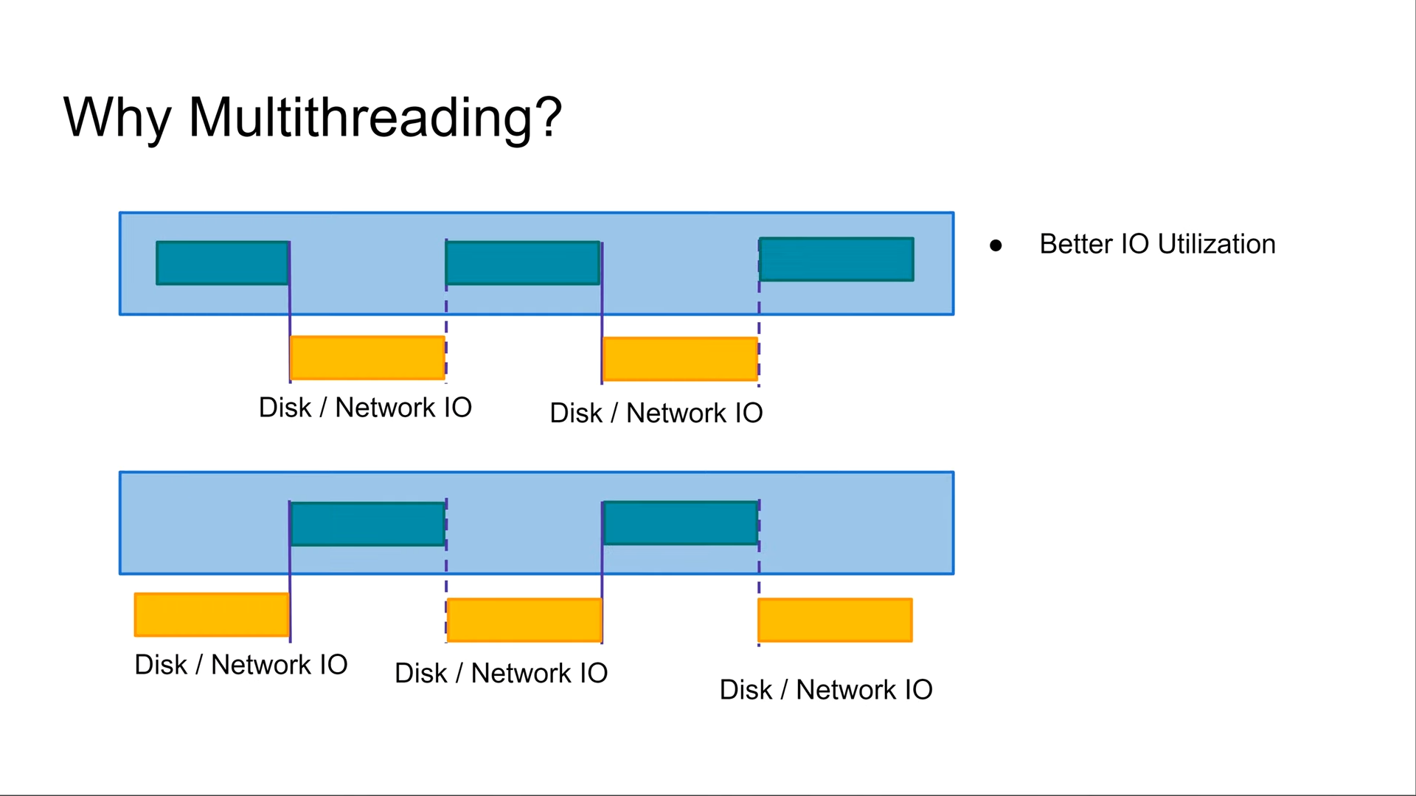
Notes:
Democratisation (means making something accessible and available to a wider range of people) and decentralisation (refers to distribution of power to authority away from a central authority or governing body to a local or regional authorities or communities)
Inclusivity and access for sellers especially small and medium enterprise as well as local businesses

Slide 7
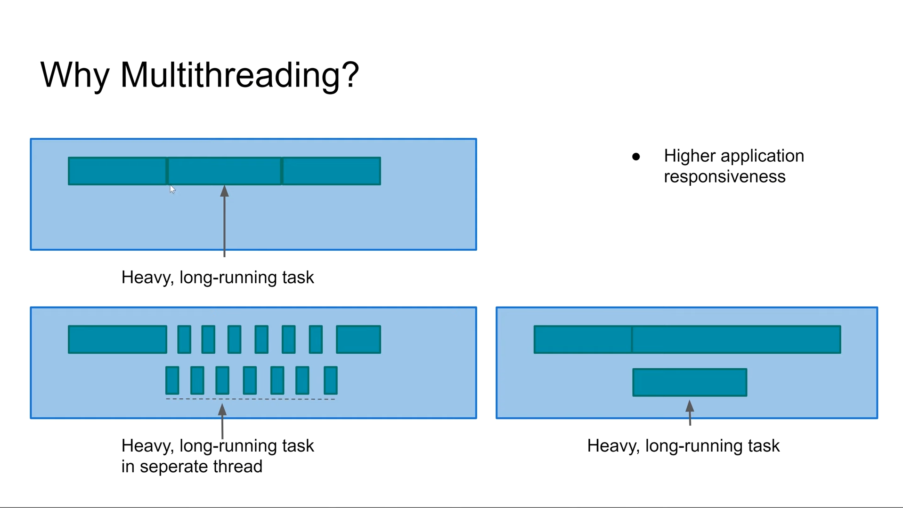
Notes:
Democratisation (means making something accessible and available to a wider range of people) and decentralisation (refers to distribution of power to authority away from a central authority or governing body to a local or regional authorities or communities)
Inclusivity and access for sellers especially small and medium enterprise as well as local businesses

Slide 8
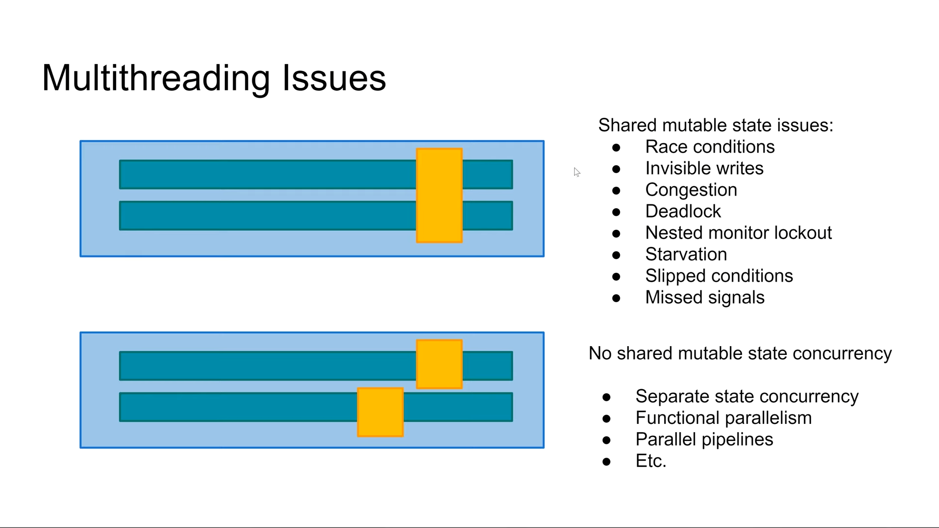
Notes:
Democratisation (means making something accessible and available to a wider range of people) and decentralisation (refers to distribution of power to authority away from a central authority or governing body to a local or regional authorities or communities)
Inclusivity and access for sellers especially small and medium enterprise as well as local businesses

Slide 9
Notes:
Democratisation (means making something accessible and available to a wider range of people) and decentralisation (refers to distribution of power to authority away from a central authority or governing body to a local or regional authorities or communities)
Inclusivity and access for sellers especially small and medium enterprise as well as local businesses

Slide 10
Notes:
Democratisation (means making something accessible and available to a wider range of people) and decentralisation (refers to distribution of power to authority away from a central authority or governing body to a local or regional authorities or communities)
Inclusivity and access for sellers especially small and medium enterprise as well as local businesses

Slide 11
Notes:
Democratisation (means making something accessible and available to a wider range of people) and decentralisation (refers to distribution of power to authority away from a central authority or governing body to a local or regional authorities or communities)
Inclusivity and access for sellers especially small and medium enterprise as well as local businesses

Slide 12
Notes:
Democratisation (means making something accessible and available to a wider range of people) and decentralisation (refers to distribution of power to authority away from a central authority or governing body to a local or regional authorities or communities)
Inclusivity and access for sellers especially small and medium enterprise as well as local businesses

Slide 13
Notes:
Democratisation (means making something accessible and available to a wider range of people) and decentralisation (refers to distribution of power to authority away from a central authority or governing body to a local or regional authorities or communities)
Inclusivity and access for sellers especially small and medium enterprise as well as local businesses

Slide 14
Notes:
Democratisation (means making something accessible and available to a wider range of people) and decentralisation (refers to distribution of power to authority away from a central authority or governing body to a local or regional authorities or communities)
Inclusivity and access for sellers especially small and medium enterprise as well as local businesses

Slide 15
Notes:
Democratisation (means making something accessible and available to a wider range of people) and decentralisation (refers to distribution of power to authority away from a central authority or governing body to a local or regional authorities or communities)
Inclusivity and access for sellers especially small and medium enterprise as well as local businesses

Slide 16
Notes:
Democratisation (means making something accessible and available to a wider range of people) and decentralisation (refers to distribution of power to authority away from a central authority or governing body to a local or regional authorities or communities)
Inclusivity and access for sellers especially small and medium enterprise as well as local businesses

Slide 17
Notes:
Democratisation (means making something accessible and available to a wider range of people) and decentralisation (refers to distribution of power to authority away from a central authority or governing body to a local or regional authorities or communities)
Inclusivity and access for sellers especially small and medium enterprise as well as local businesses

Slide 18
Notes:
Democratisation (means making something accessible and available to a wider range of people) and decentralisation (refers to distribution of power to authority away from a central authority or governing body to a local or regional authorities or communities)
Inclusivity and access for sellers especially small and medium enterprise as well as local businesses

Slide 19
Notes:
Democratisation (means making something accessible and available to a wider range of people) and decentralisation (refers to distribution of power to authority away from a central authority or governing body to a local or regional authorities or communities)
Inclusivity and access for sellers especially small and medium enterprise as well as local businesses

Slide 20
Notes:
Democratisation (means making something accessible and available to a wider range of people) and decentralisation (refers to distribution of power to authority away from a central authority or governing body to a local or regional authorities or communities)
Inclusivity and access for sellers especially small and medium enterprise as well as local businesses

Slide 21
Notes:
Democratisation (means making something accessible and available to a wider range of people) and decentralisation (refers to distribution of power to authority away from a central authority or governing body to a local or regional authorities or communities)
Inclusivity and access for sellers especially small and medium enterprise as well as local businesses

Slide 22
Notes:
Democratisation (means making something accessible and available to a wider range of people) and decentralisation (refers to distribution of power to authority away from a central authority or governing body to a local or regional authorities or communities)
Inclusivity and access for sellers especially small and medium enterprise as well as local businesses

Slide 23
Notes:
Democratisation (means making something accessible and available to a wider range of people) and decentralisation (refers to distribution of power to authority away from a central authority or governing body to a local or regional authorities or communities)
Inclusivity and access for sellers especially small and medium enterprise as well as local businesses

Slide 24
Notes:
Democratisation (means making something accessible and available to a wider range of people) and decentralisation (refers to distribution of power to authority away from a central authority or governing body to a local or regional authorities or communities)
Inclusivity and access for sellers especially small and medium enterprise as well as local businesses

Slide 25
Notes:
Democratisation (means making something accessible and available to a wider range of people) and decentralisation (refers to distribution of power to authority away from a central authority or governing body to a local or regional authorities or communities)
Inclusivity and access for sellers especially small and medium enterprise as well as local businesses

Slide 26
Notes:
Democratisation (means making something accessible and available to a wider range of people) and decentralisation (refers to distribution of power to authority away from a central authority or governing body to a local or regional authorities or communities)
Inclusivity and access for sellers especially small and medium enterprise as well as local businesses

Slide 27
Notes:
Democratisation (means making something accessible and available to a wider range of people) and decentralisation (refers to distribution of power to authority away from a central authority or governing body to a local or regional authorities or communities)
Inclusivity and access for sellers especially small and medium enterprise as well as local businesses

Slide 28
Notes:
Democratisation (means making something accessible and available to a wider range of people) and decentralisation (refers to distribution of power to authority away from a central authority or governing body to a local or regional authorities or communities)
Inclusivity and access for sellers especially small and medium enterprise as well as local businesses

Slide 29

Thank you
www.zestic.in
Contact us: www.zestic.in/contact-us
All information present here is the exclusive property of Zestic IT Solutions (Zestic) and is subject to change without notice. Any unauthorized use of the content appearing here may violate copyright, trademark and other applicable laws.

